Slide 1

Logistic Regression Algorithm
Learn easy. Enjoy Easy. Expertise easy
Notes:
Use this logistic regression to create the new slides
https://towardsdatascience.com/logistic-regression-for-dummies-a-detailed-explanation-9597f76edf46
https://towardsdatascience.com/understanding-logistic-regression-9b02c2aec102
Maganize problem
https://towardsdatascience.com/real-world-implementation-of-logistic-regression-5136cefb8125

Slide 2
What Is Logistic Regression ?
Logistic regression is a statistical method for analysing a dataset in which there are one or more independent variables that determine an outcome.
The outcome is measured with a dichotomous variable (in which there are only two possible outcomes).
It is used to predict a binary outcome (1 / 0, Yes / No, True / False) given a set of independent variables.

Slide 3
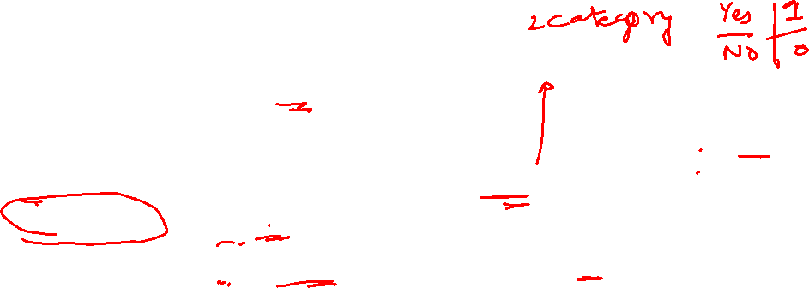
What Is Logistic Regression ?
You can also think of logistic regression as a special case of linear regression when the outcome variable is categorical, where we are using log of odds as dependent variable. In simple words, it predicts the probability of occurrence of an event by fitting data to a logit function.
Multinomial logistic regression
There are some cases where dependent variables can have more than two outcomes, like married /unmarried/divorced such scenarios are classified as multinomial logistic regression. Though they work in the same manner to predict the outcome .

Slide 4
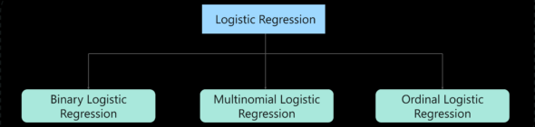
Types of Logistic Regression ?
Binary logistic regression – It has only two possible outcomes. Example- yes or no
Multinomial logistic regression – It has three or more nominal categories. Example- cat, dog, elephant.
Ordinal logistic regression- It has three or more ordinal categories, ordinal meaning that the categories will be in a order. Example- user ratings(1-5).
Notes:
Binary logistic regression – It has only two possible outcomes. Example- yes or no
Multinomial logistic regression – It has three or more nominal categories. Example- cat, dog, elephant.
Ordinal logistic regression- It has three or more ordinal categories, ordinal meaning that the categories will be in a order. Example- user ratings(1-5).

Slide 5

Examples
Buy Magazine :Buy (y) a particular magazine or not.
Diabetes Prediction: Diabetic/Not Diabetic
Email Spam Filter: Spam /No Spam
Fraud Detection : Transaction is fraudulent, Yes/No
Tumor: Benign/Malignant

Slide 6
Logistic Regression how it works

Slide 7

to predict the probability whether a customer will buy (y) a particular magazine – 1 input - age
Suppose we have sample of 1000 customers.
We need to predict the probability whether a customer of a Particular Age(Age) will buy (y) a particular magazine or not.
As we’ve a categorical outcome variable, we’ll use logistic regression.
Notes:
We are provided a sample of 1000 customers.
We need to predict the probability whether a customer of a Particular Age will buy (y) a particular magazine or
not.
As we’ve a categorical outcome variable, we’ll use logistic regression.

Slide 8
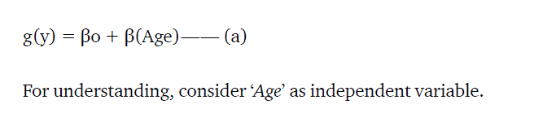
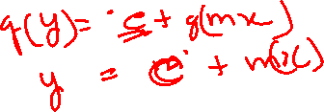
Linear to Logistic – (a)
To start with logistic regression, first write the simple linear regression equation with dependent variable enclosed in a link function:

Slide 9
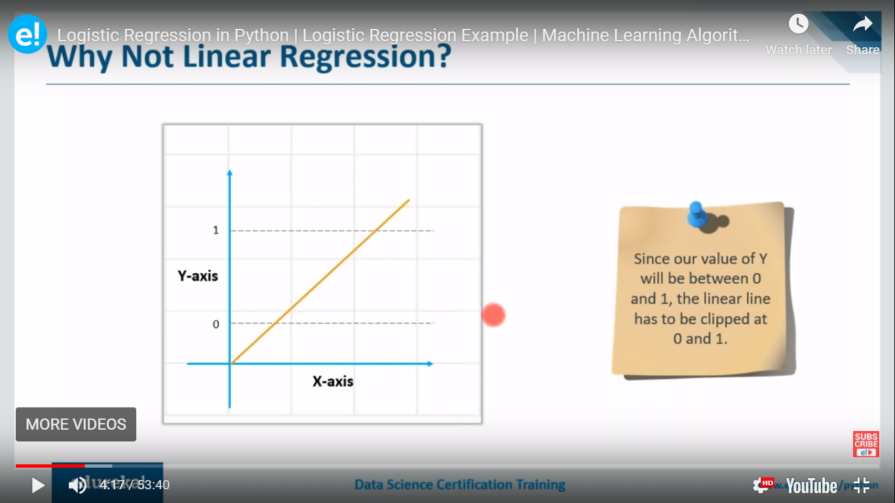
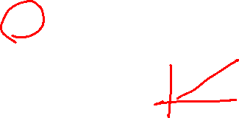
Linear Regression
+ infinity
- infinity

Slide 10
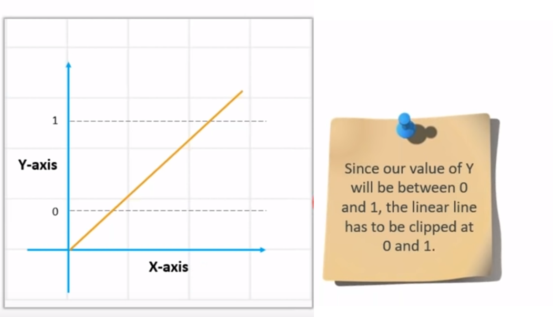
Linear regression equation: y = β0 + β1X1 + β2X2 …. + βxnxn

Slide 11
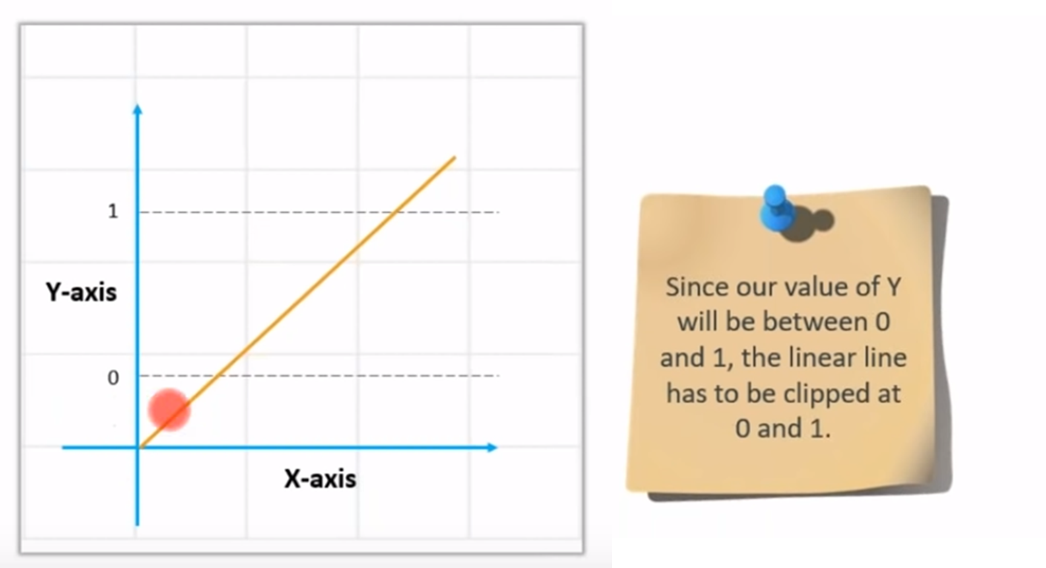
Value of Y – between 0 and 1
For Y = As our prediction value should be between 0 and 1

Slide 12
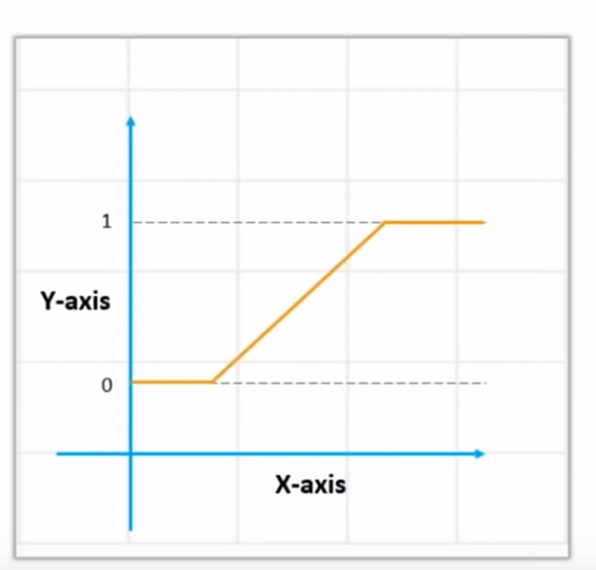
How to get the value of 0 and 1

Slide 13
How to get the value of 0 and 1? Use Sigmoid
We Apply sigmoid function on the linear regression equation to get the S-curve so that it lies between 0 and 1
Sigmoid function: p = 1 / 1 + e^{-y}
A sigmoid function is a mathematical function/equation having a characteristic "S"-shaped curve or sigmoid curve.

Slide 14
Convert Linear to Logistics
Linear regression equation: y = β0 + β1X1 + β2X2 …. + βnXn
Sigmoid function: p = 1 / 1 + e^{-y}
y in sigmoid is replaced
So our Logistic Regression equation: p = 1 / 1 + e^{-(β0 + β1X1 + β2X2 …. + βnXn)}

Slide 15
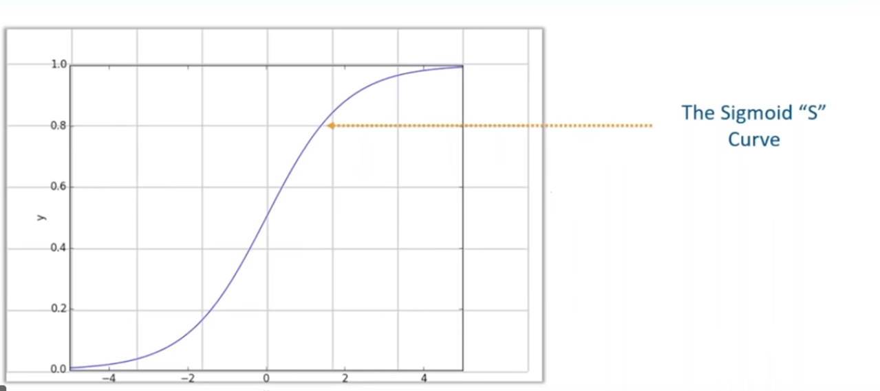
Sigmoid – S-curve

Slide 16
Sigmoid
Sigmoid curve converts any value from
-infinity to +infinity to (0 to 1)
Sigmoid will output:
‘0’ as x approaches −∞
‘1’ as x approaches +∞

Slide 17
Linear Regression Transformed to Logistic Regression
+ infinity
- infinity

Slide 18
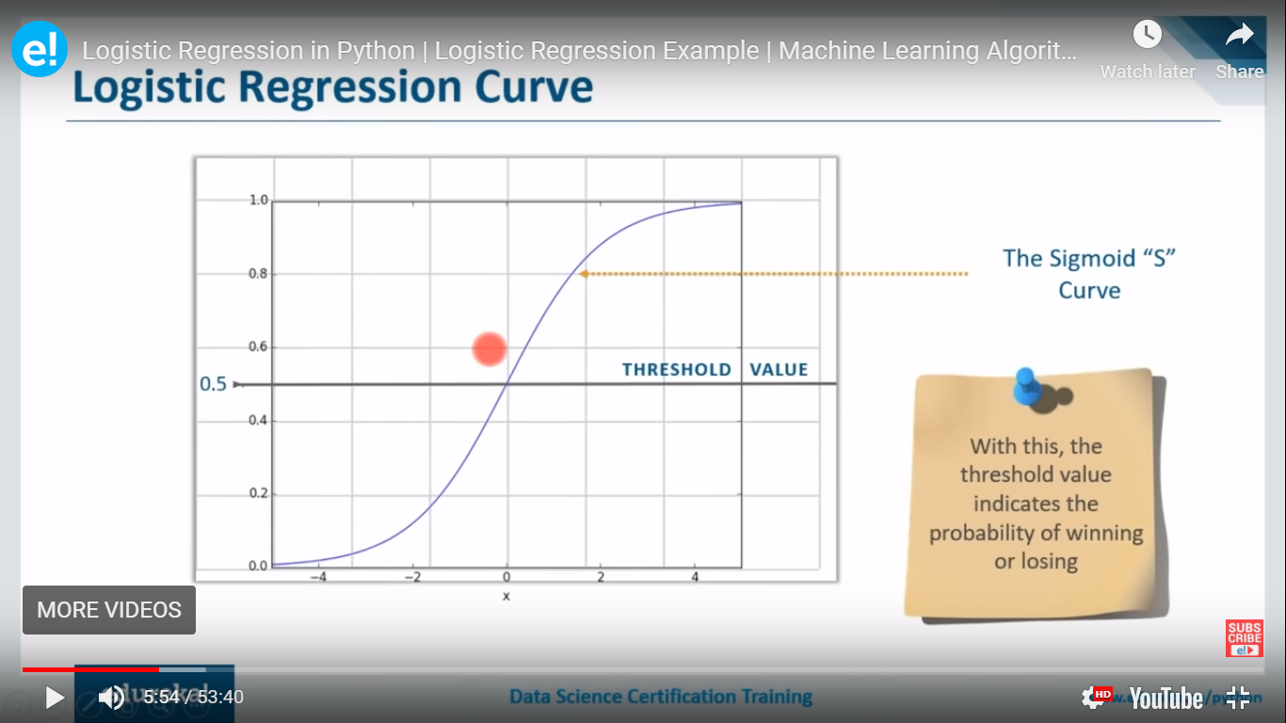
Probability values for the answers
.8 becomes 1
.2 becomes 0

Slide 20
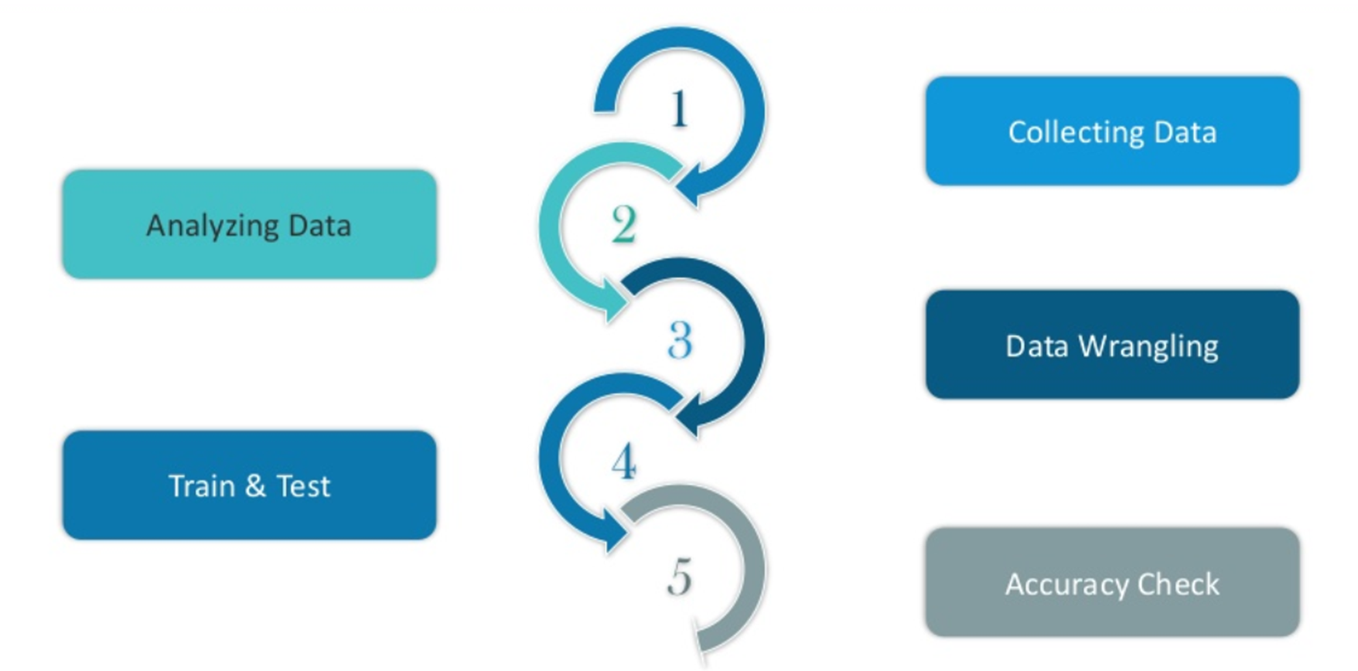
Logistic Regression Approach

Slide 21
to predict the probability whether a customer will buy (y) a particular magazine
In this use case, a magazine reseller is trying to decide what magazines to market to customers. In the “old days,” this might have involved trying to decide which customers to send advertisements to via regular mail. In the context of today and the “web,” this might involved deciding what recommendations to make to a customer viewing a web page about other items that the customer might be interested in and therefore want to buy. The two problems are essentially the same.
Notes:
We are provided a sample of 1000 customers.
We need to predict the probability whether a customer of a Particular Age will buy (y) a particular magazine or
not.
As we’ve a categorical outcome variable, we’ll use logistic regression.

Slide 22
Data Description
BUY
Household Income (Income; rounded to the nearest $1,000.00)
Gender (IsFemale = 1 if the person is female, 0 otherwise)
Marital Status (IsMarried = 1 if married, 0 otherwise)
College Educated (HasCollege = 1 if has one or more years of college education, 0 otherwise)
Employed in a Profession (IsProfessional = 1 if employed in a profession, 0 otherwise)
Retired (IsRetired = 1 if retired, 0 otherwise)
Not employed (Unemployed = 1 if not employed, 0 otherwise)
Notes:
We are provided a sample of 1000 customers.
We need to predict the probability whether a customer of a Particular Age will buy (y) a particular magazine or
not.
As we’ve a categorical outcome variable, we’ll use logistic regression.

Slide 23
Data Description
Length of Residency in Current City (ResLength; in years)
Dual Income if Married (Dual = 1 if dual income, 0 otherwise)
Children (Minors = 1 if children under 18 are in the household, 0 otherwise)
Home ownership (Own = 1 if own residence, 0 otherwise)
Resident type (House = 1 if the residence is a single-family house, 0 otherwise)
Race (White = 1 if the race is white, 0 otherwise)
Language (English = 1 is the primary language in the household is English, 0 otherwise)
Notes:
We are provided a sample of 1000 customers.
We need to predict the probability whether a customer of a Particular Age will buy (y) a particular magazine or
not.
As we’ve a categorical outcome variable, we’ll use logistic regression.

Slide 24
Model Evaluation
Confusion Matrix
ROC CURVE
AUC

Slide 25
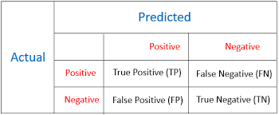
Logistic Model Evaluation
Confusion Matrix

Slide 26
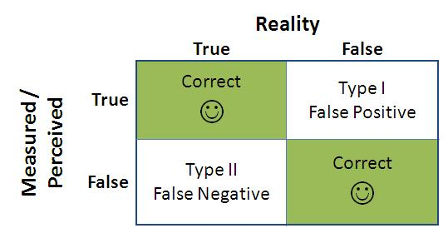
Type I and Type II errors

Slide 27
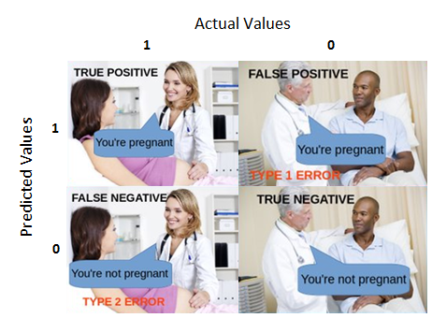
Type I and Type ii ( False Positive, False Negative)

Slide 28
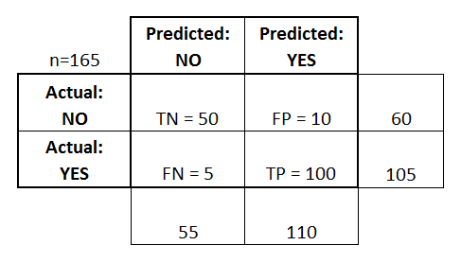
Confusion Matrix

Slide 29
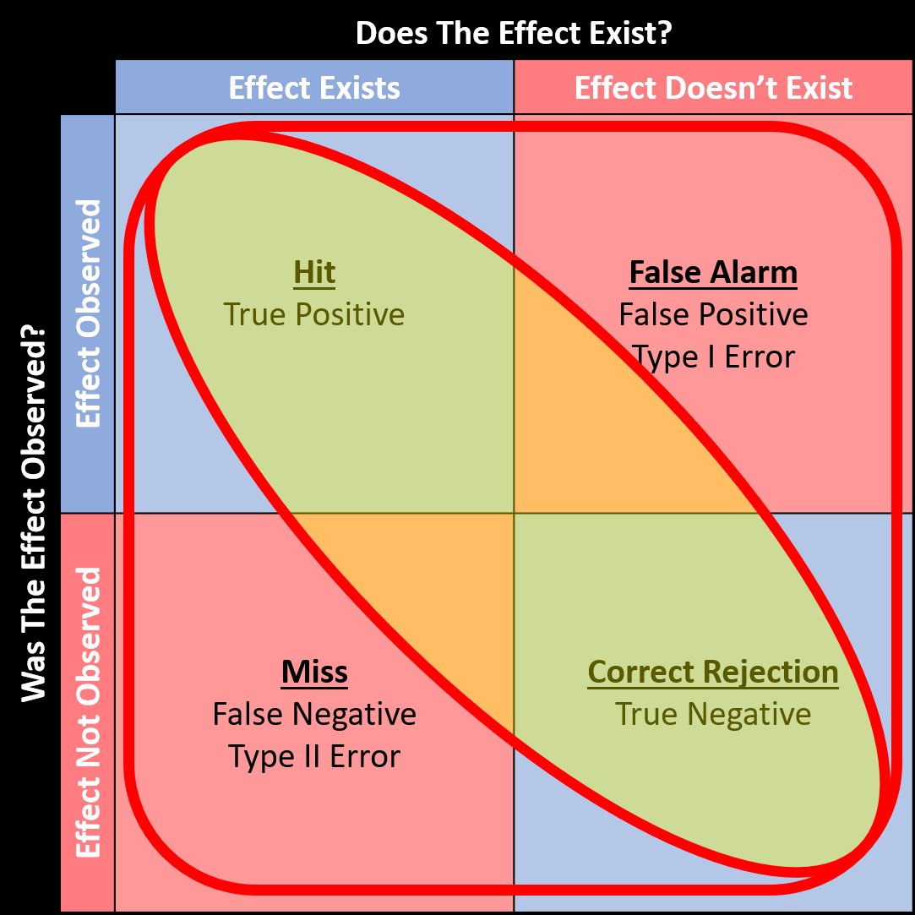
Confusion Matrix

Slide 30
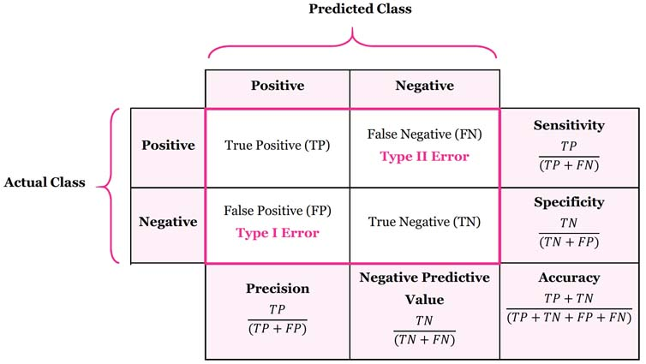

Slide 31
Approach
Collect Data: Import Libraries
Analysing Data
Data Wrangling
Train and Test Data
Accuracy Check
Notes:
We are provided a sample of 1000 customers.
We need to predict the probability whether a customer of a Particular Age will buy (y) a particular magazine or
not.
As we’ve a categorical outcome variable, we’ll use logistic regression.

Slide 32
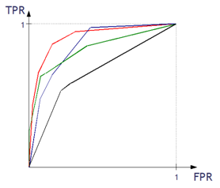
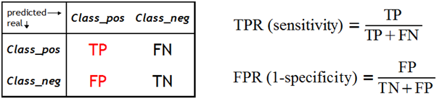
What is the ROC curve?
The ROC curve is one of the methods for visualizing classification quality, which shows the dependency between TPR (True Positive Rate) and FPR (False Positive Rate).
Notes:
http://algolytics.com/how-to-assess-quality-and-correctness-of-classification-models-part-4-roc-curve/
The more convex the curve, the better the classifier. In the example below, the “green” classifier is better in area 1, and the “red” classifier is better in area 2

Slide 33
How is the ROC curve created
We compute the values of the decision function.
We test the classifier for different alpha thresholds. Recall that alpha is the threshold of the estimated probability, above which an observation is assigned to one category (positive class) and below to the other category (negative class).
For each classification with one value of the alpha threshold we obtain a (TPR, FPR) pair, which corresponds to one point on the ROC curve.
For each classification with one value of the alpha threshold we also have the corresponding Confusion Matrix.
Notes:
http://algolytics.com/how-to-assess-quality-and-correctness-of-classification-models-part-4-roc-curve/
The more convex the curve, the better the classifier. In the example below, the “green” classifier is better in area 1, and the “red” classifier is better in area 2

Slide 34
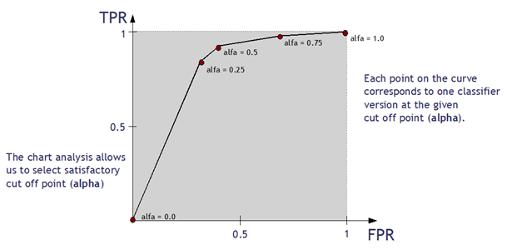
How is the ROC curve created
We compute the values of the decision function.
Notes:
http://algolytics.com/how-to-assess-quality-and-correctness-of-classification-models-part-4-roc-curve/
The more convex the curve, the better the classifier. In the example below, the “green” classifier is better in area 1, and the “red” classifier is better in area 2

Slide 35
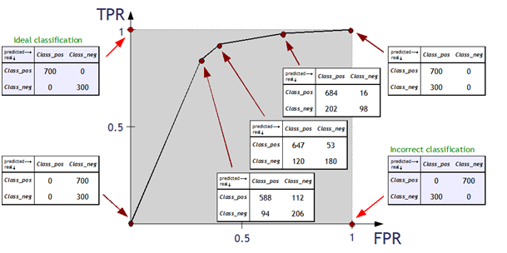
How is the ROC curve created
We compute the values of the decision function.
Notes:
http://algolytics.com/how-to-assess-quality-and-correctness-of-classification-models-part-4-roc-curve/
The more convex the curve, the better the classifier. In the example below, the “green” classifier is better in area 1, and the “red” classifier is better in area 2

Slide 36
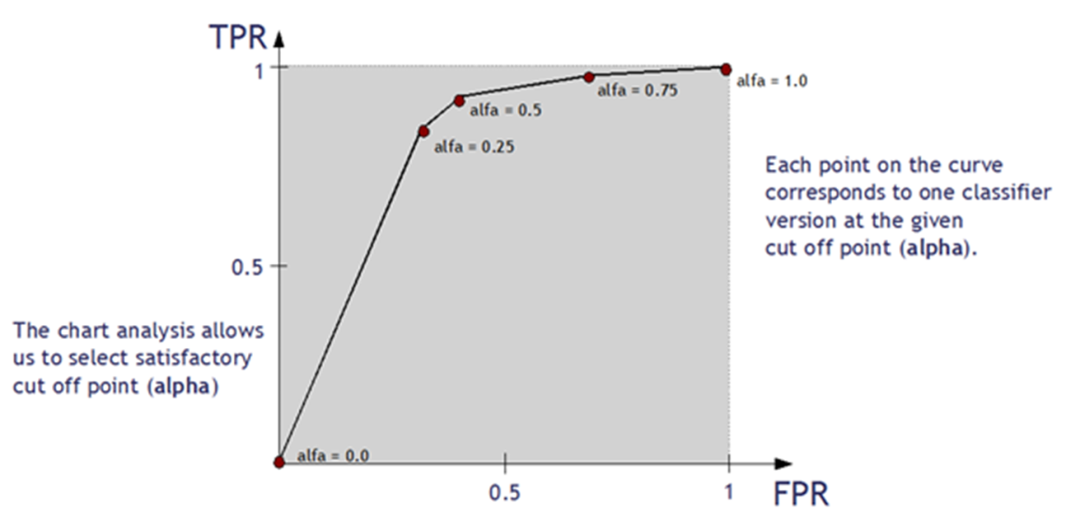
How is the ROC curve created
We compute the values of the decision function.
Notes:
http://algolytics.com/how-to-assess-quality-and-correctness-of-classification-models-part-4-roc-curve/
The more convex the curve, the better the classifier. In the example below, the “green” classifier is better in area 1, and the “red” classifier is better in area 2

Slide 37
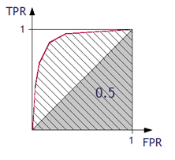
Assessing the classifier using ROC curve
Area under ROC Curve (AUC) coefficient
The higher the value of AUC coefficient, the better. AUC = 1 means a perfect classifier, AUC = 0.5 is obtained for purely random classifiers. AUC < 0.5 means the classifier performs worse than a random one.
Gini Coefficient: GC = 2 *AUC – 1 (the classifier’s advantage over a purely random one)
The higher the value of GC, the better. GC = 1 denotes a perfect classifier, GC = 0 denotes a purely random one.
Notes:
http://algolytics.com/how-to-assess-quality-and-correctness-of-classification-models-part-4-roc-curve/
The more convex the curve, the better the classifier. In the example below, the “green” classifier is better in area 1, and the “red” classifier is better in area 2

Slide 38
What is the ROC curve?
Notes:
We are provided a sample of 1000 customers.
We need to predict the probability whether a customer of a Particular Age will buy (y) a particular magazine or
not.
As we’ve a categorical outcome variable, we’ll use logistic regression.

Slide 39
Data Description
Length of Residency in Current City (ResLength; in years)
Dual Income if Married (Dual = 1 if dual income, 0 otherwise)
Children (Minors = 1 if children under 18 are in the household, 0 otherwise)
Home ownership (Own = 1 if own residence, 0 otherwise)
Resident type (House = 1 if the residence is a single-family house, 0 otherwise)
Race (White = 1 if the race is white, 0 otherwise)
Language (English = 1 is the primary language in the household is English, 0 otherwise)
Notes:
We are provided a sample of 1000 customers.
We need to predict the probability whether a customer of a Particular Age will buy (y) a particular magazine or
not.
As we’ve a categorical outcome variable, we’ll use logistic regression.

Slide 40
Data Description
Length of Residency in Current City (ResLength; in years)
Dual Income if Married (Dual = 1 if dual income, 0 otherwise)
Children (Minors = 1 if children under 18 are in the household, 0 otherwise)
Home ownership (Own = 1 if own residence, 0 otherwise)
Resident type (House = 1 if the residence is a single-family house, 0 otherwise)
Race (White = 1 if the race is white, 0 otherwise)
Language (English = 1 is the primary language in the household is English, 0 otherwise)
Notes:
We are provided a sample of 1000 customers.
We need to predict the probability whether a customer of a Particular Age will buy (y) a particular magazine or
not.
As we’ve a categorical outcome variable, we’ll use logistic regression.

Slide 43
Thank you
arunkg99@gmail.com
www.doitskills.com

